Slide 1
Manufacturing Analytics

Slide 2
OVERVIEW
The Manufacturing Analytics project focuses on leveraging data analytics to optimize manufacturing operations by analyzing real-time and historical production data. It aims to improve efficiency, reduce downtime, enhance product quality, and support data-driven decision-making. By integrating tools like SQL, Python, and visualization platforms such as Power BI or Tableau, the project enables actionable insights through performance monitoring, predictive maintenance, and process optimization. Ultimately, it helps streamline production, minimize costs, and boost overall productivity in the manufacturing environment

Slide 3
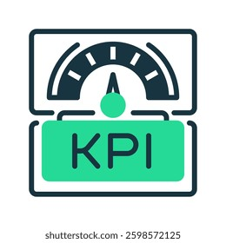
Key Performance Indicator
Key Performance Indicators (KPIs)The dashboard highlights four primary KPIs to monitor manufacturing performance:
Total Manufactured Quantity: 4,97,90,600
Total Processed Quantity: 6,00,22,534
Total Rejected Quantity: 4,91,023
Total Wastage Quantity:-
i. First Dashboard: 74,93,526
Ii. Second Dashboard: 4,92,99,577

Slide 4
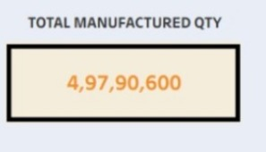
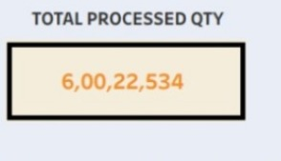
KPI OBJECTIVES
Total Manufactured Quantity Objective: To track the total output produced in a given time period, ensuring that production targets are being met and plant capacity is being utilized efficiently.
Total Processed Quantity Objective: To monitor how much of the manufactured quantity has been successfully processed through various production or inspection stages, indicating operational throughput and workflow efficiency.

Slide 5
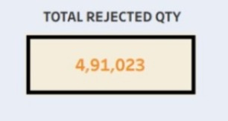
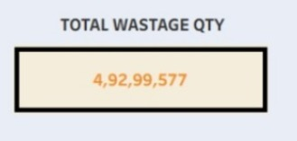
Total Rejected Quantity Objective :To measure the number of units that failed quality standards, helping identify process inefficiencies, quality issues, or training needs to reduce scrap or rework.
Total Wastage Quantity Objective: To quantify material loss or unusable output during manufacturing, with the aim of minimizing waste, improving yield, and enhancing sustainability.
First Dashboard Wastage Objective: To monitor wastage from specific machines, processes, or production lines captured in the First Dashboard, helping drive localized improvements.
b. Second Dashboard Wastage Objective: To track wastage at another level (e.g., plant-wide, shift-wise, or after further processing) as per the Second Dashboard, giving a broader or comparative perspective on material efficiency.

Slide 6
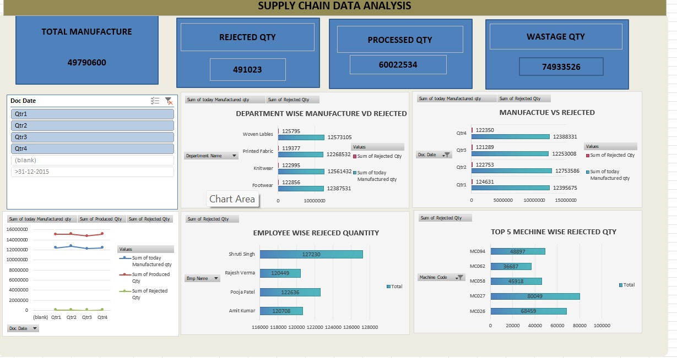
EXCEL DASHBOARD

Slide 7
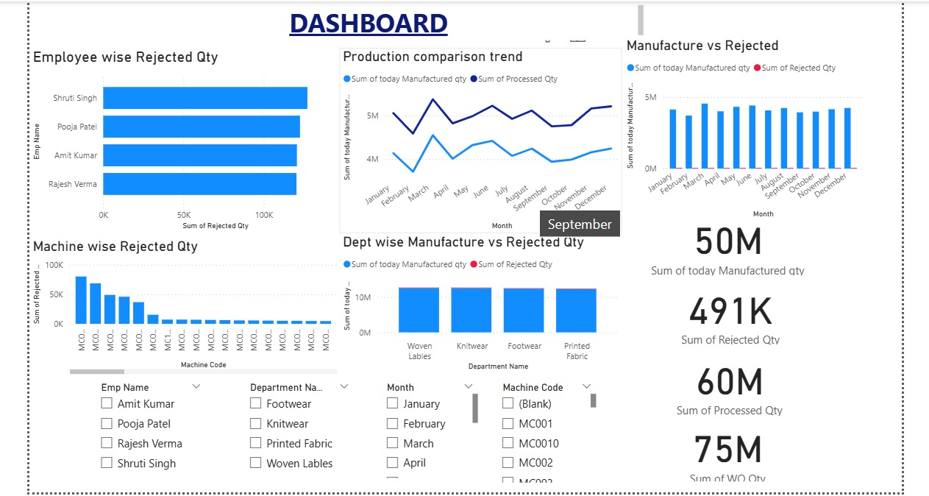
POWER BI DASHBOARD

Slide 8
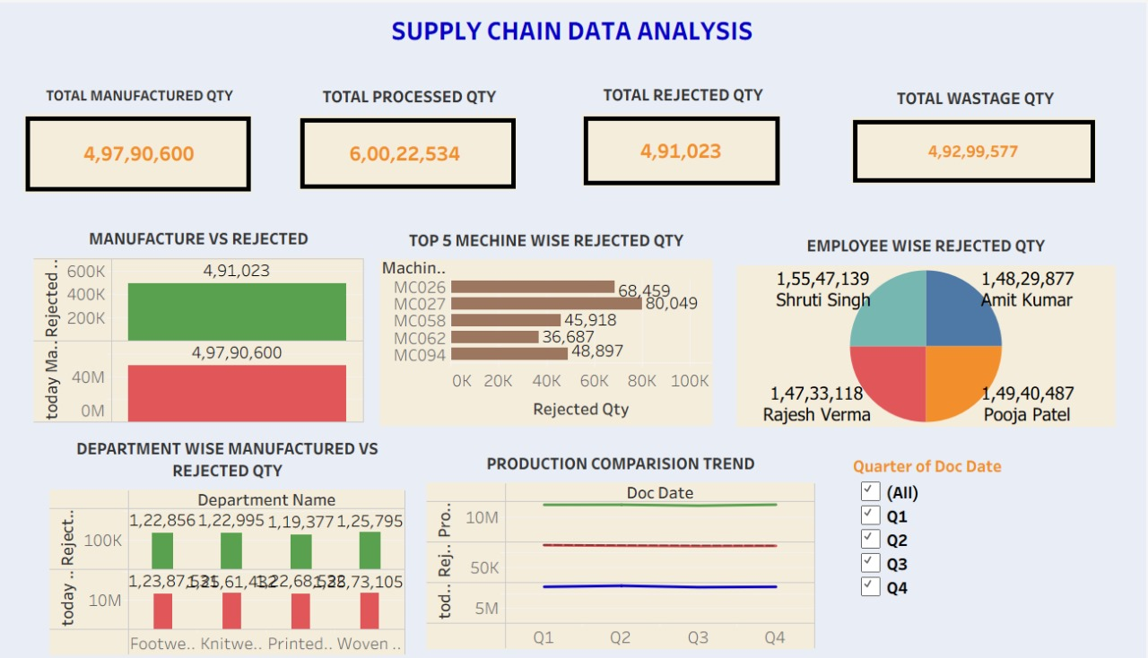
TABLAUE DASHBOARD

Slide 9
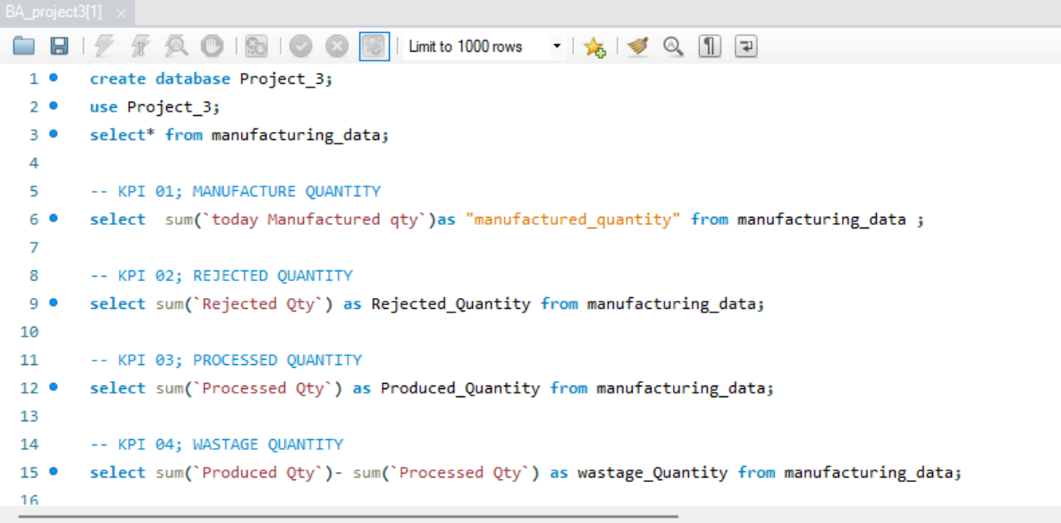
SQL QUERIES

Slide 10
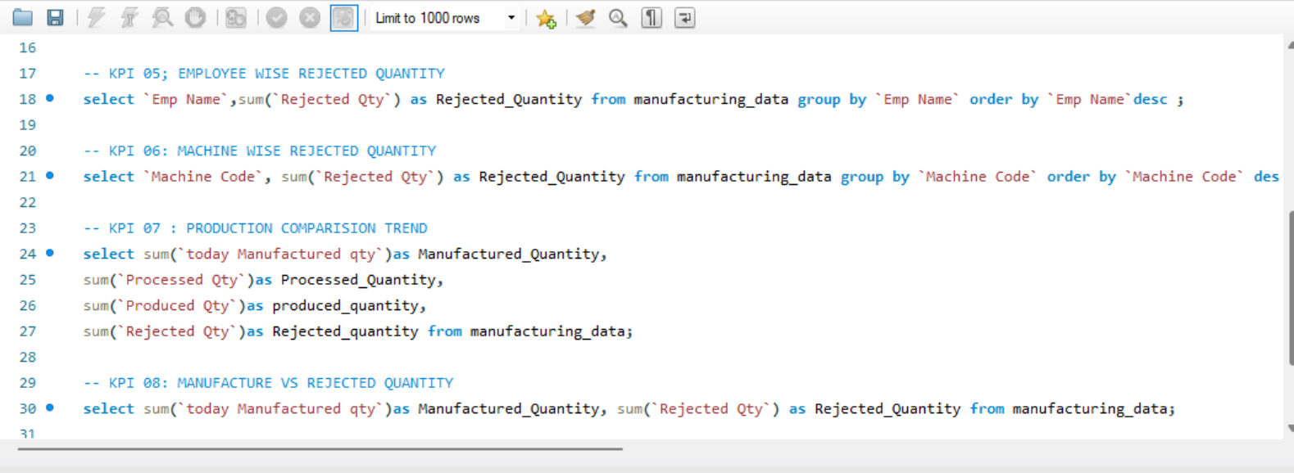

Slide 11
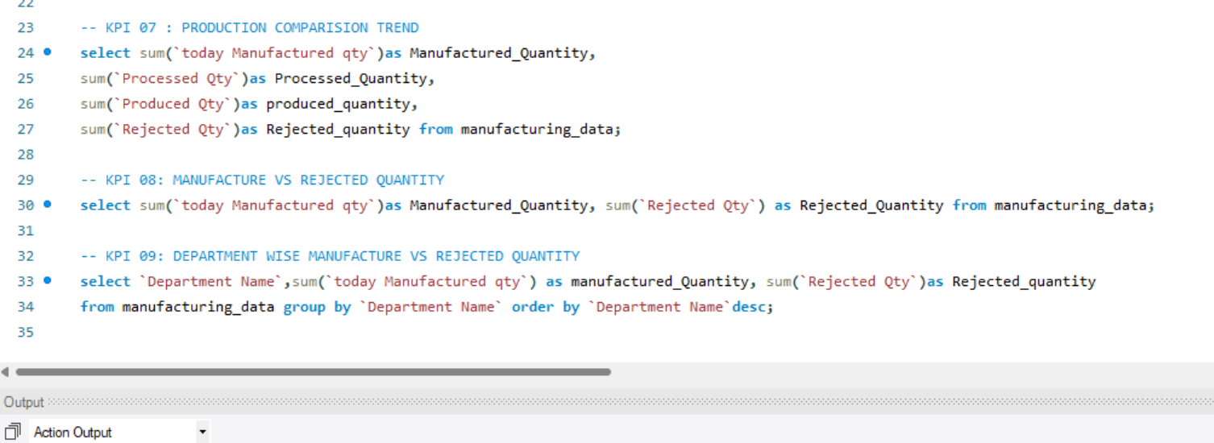

Slide 12
KEY TAKEAWAYS
High Manufacturing Volume: A significant quantity of 4.97 crore units was manufactured, indicating robust production capacity and operational scale.
Processed Quantity Exceeds Manufactured Quantity: The processed quantity (6.00 crore) is unusually higher than the manufactured quantity, suggesting:
Possible data duplication
Reprocessing of units
Or an inconsistency in data reporting
Rejected Quantity is Relatively Low: Only 4.91 lakh units were rejected, which is a low rejection rate, reflecting good quality control or effective process management.
Wastage is Substantial but Needs Clarification: The total wastage reported across two dashboards is:
74.93 lakh (First Dashboard)
4.93 crore (Second Dashboard) This shows a large volume of waste, possibly indicating:
Inefficient processes
Material loss during multiple stages
Or differing calculation methods across dashboards
Data Consistency Should be Verified: The mismatch between processed and manufactured quantities, and the dual wastage values, highlight the need for data validation and harmonization across systems or dashboards

Slide 13
CONCULSION
These discrepancies raise concerns about the reliability of the current data being used for performance evaluation.
To ensure accurate tracking and effective decision-making, it's important to align all data sources and validate the collected metrics.
Implementing standardized reporting practices across all dashboards will improve consistency and data accuracy.
Addressing these issues will enhance transparency, reduce unnecessary waste, and support continuous improvement in the overall manufacturing process.
The KPIs demonstrate a strong overall manufacturing output, showing that production processes are running at a high capacity.
A relatively low rejection rate indicates that quality control measures are effective and that most products meet required standards.
However, there is a noticeable inconsistency where the processed quantity is higher than the manufactured quantity, suggesting possible reprocessing cycles or data entry errors.
Significant differences in reported wastage between the two dashboards point to a lack of consistency in data collection or reporting methods.

Slide 14


